Slide 1
Figures and tables from Lena Struwe’s The Naming of Plants (2018, v.1) © Lena Struwe, 2018 Feel free to copy, resize, and use in presentations and other materials as long as source and copyright is indicated (see manual for specific copyright and use information).

Slide 2
The Codes
Code | Organisms:
International Code of Nomenclature for Algae, Fungi, and Plants (ICN) | ALGAE, BACTERIA (Cyanobacteria only), FUNGI, PLANTS, photosynthetic PROTISTS: Species, Subspecies, Variety, Genus, Family, Order, Classes, etc. (scientific names for all taxonomic ranks); Hybrids
International Code of Nomenclature for Cultivated Plants (ICNCP) | CULTIVATED PLANTS: Cultivars, Groups (ranks for cultivated names)
International Code of Zoological Nomenclature (ICZN) | ANIMALS, PROTISTS (except photosynthetic and some previously considered fungi): Species, Subspecies, Variety, Genus, Family, Order, Classes, etc. (scientific names for all taxonomic ranks); Hybrids
International Code of Nomenclature of Prokaryotes (ICNP) | ARCHAEA, BACTERIA (not Cyanobacteria): Species, Subspecies, Variety, Genus, Family, Order, Classes (scientific names for all taxonomic ranks)
International Code of Virus Classification and Nomenclature (ICVCN) | VIRUSES: various names and groups
The formal codes that regulate scientific names and the organisms they cover.

Slide 3
Endings in botanical nomenclature
Class -opsida Magnoliopsida
Subclass -idae Magnoliidae
Superorder -anae Magnolianae
Order -ales Magnoliales
Family -aceae Magnoliaceae
Subfamily -oideae Magnolioideae
Tribe -eae Magnolieae
Subtribe -inae Magnoliinae
Genus [various] Magnolia
Species [various] Magnolia grandiflora

Slide 4
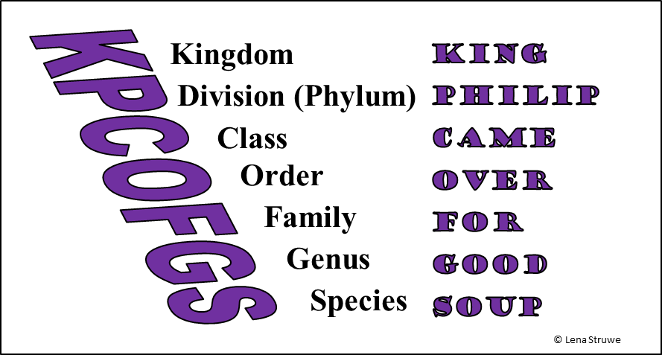
Ranks
© Lena Struwe

Slide 5
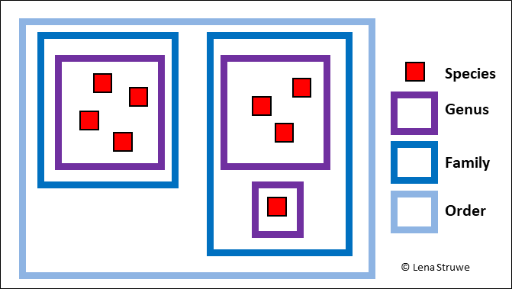
Nested hierarchy

Slide 6
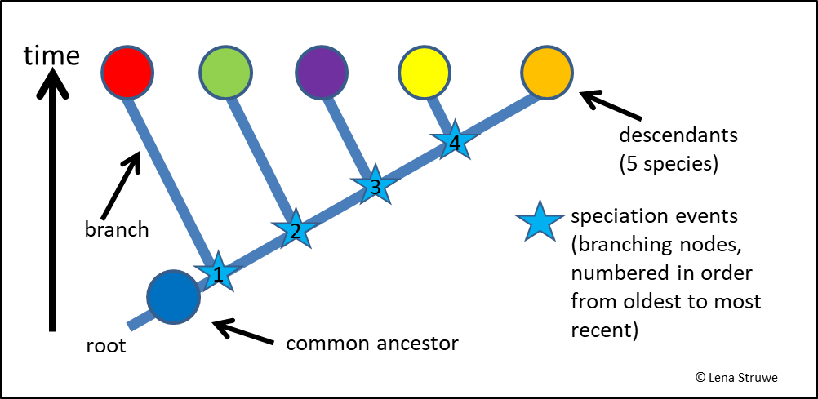
Phylogeny - terminology

Slide 7
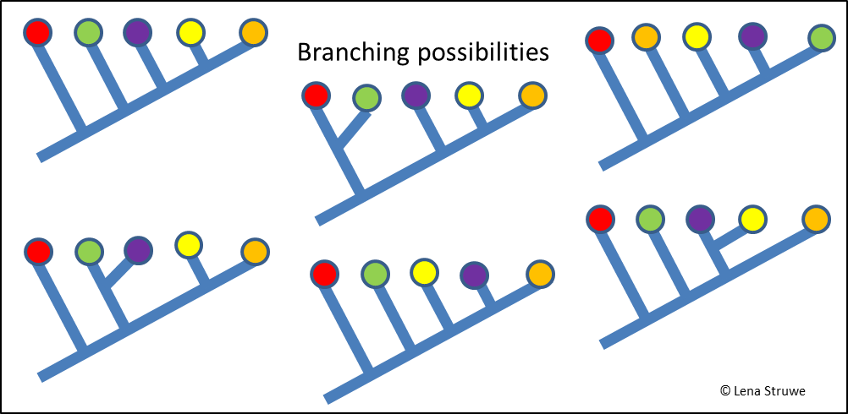
Branching possibilities

Slide 8
Monophyly, clades

Slide 9
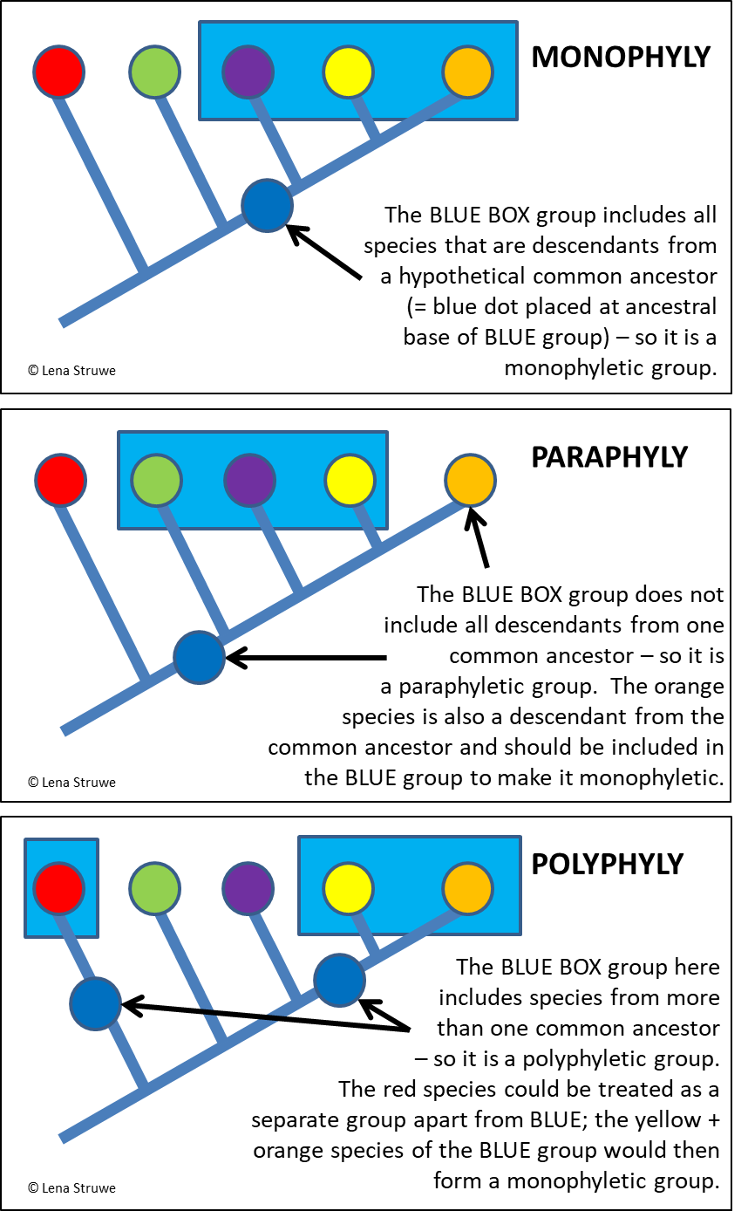
Monophyly, paraphyly, polyphyly

Slide 10
Monophyly

Slide 11
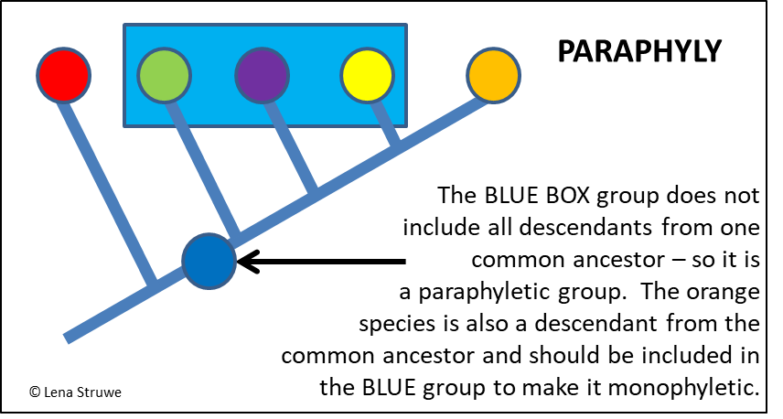
Paraphyly

Slide 12
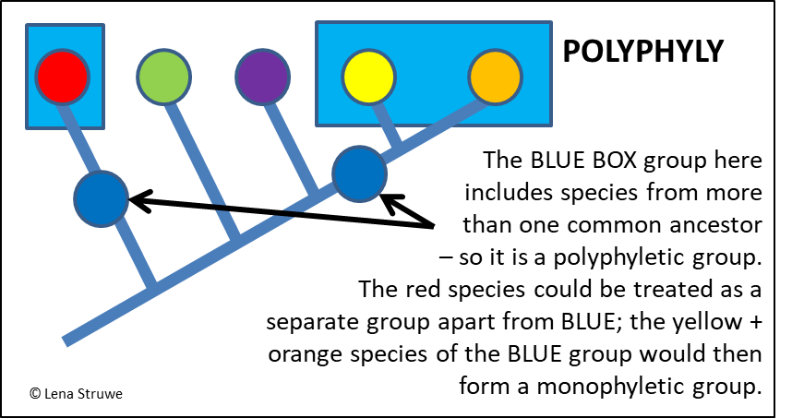
Polyphyly

Slide 13
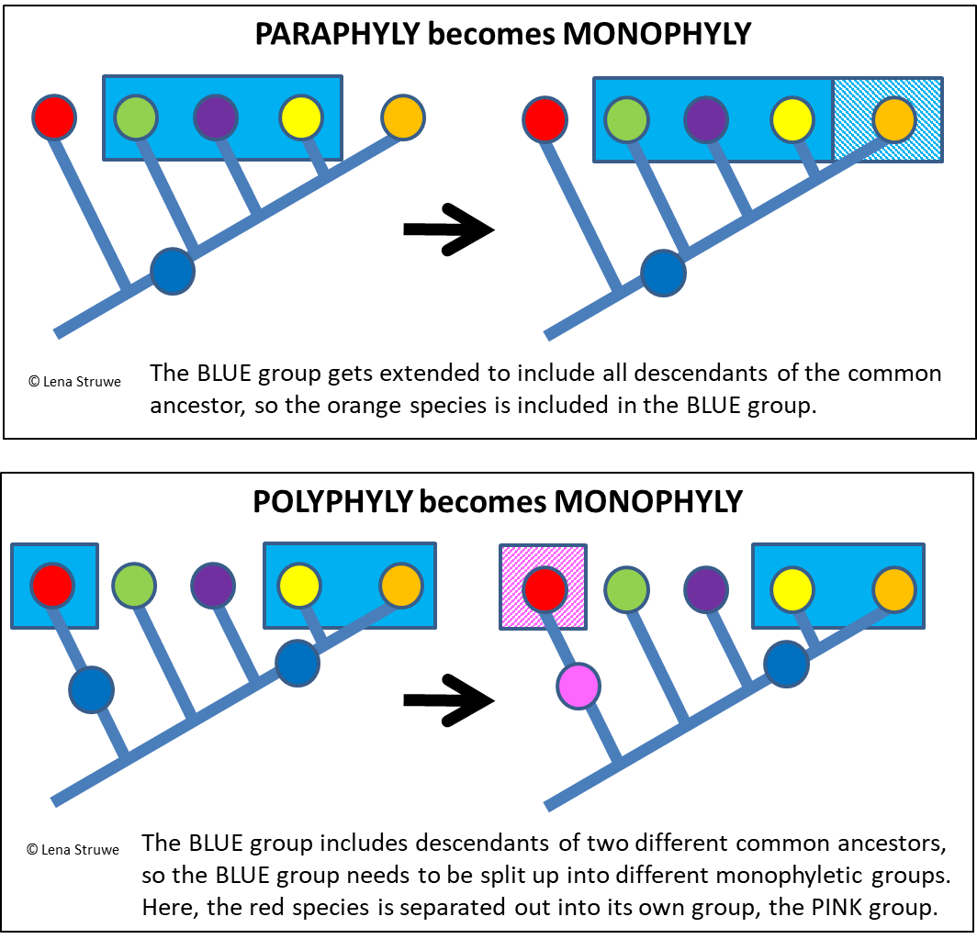
Reclassifying

Slide 14
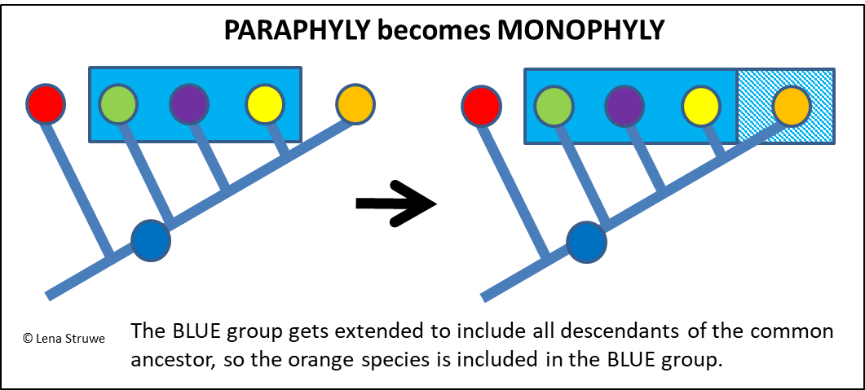
Paraphyly becomes monophyly

Slide 15
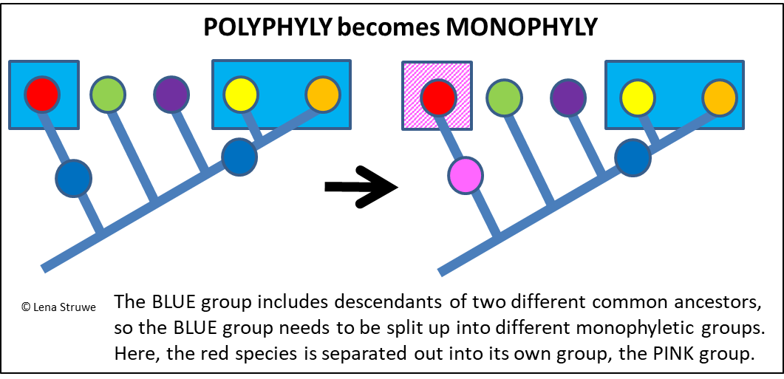
Polyphyly becomes monophyly

Slide 16
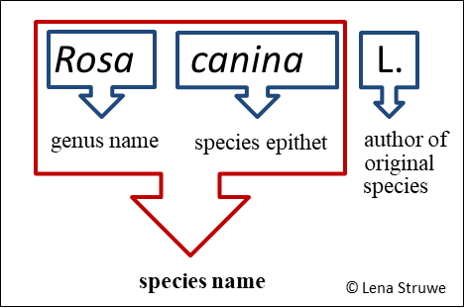
Binomial names

Slide 17
Moving to a new genus

Slide 18
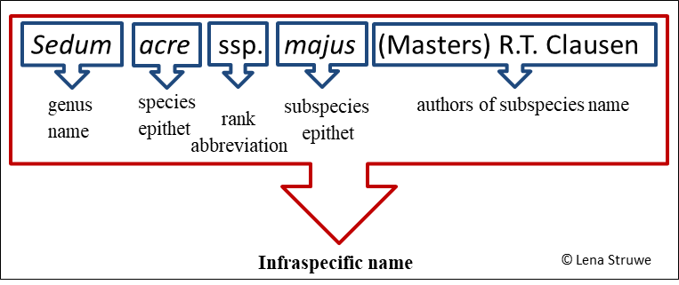
Infraspecific names

Slide 19
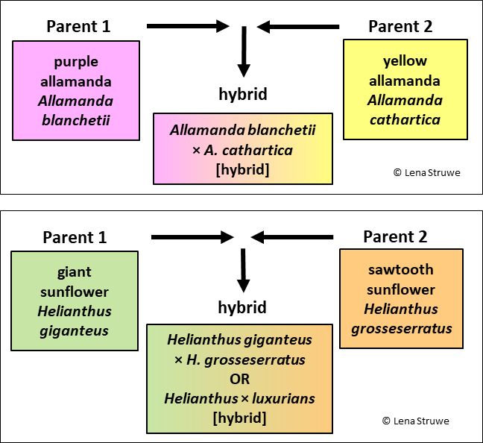
Hybrid names between species in the same genus

Slide 20
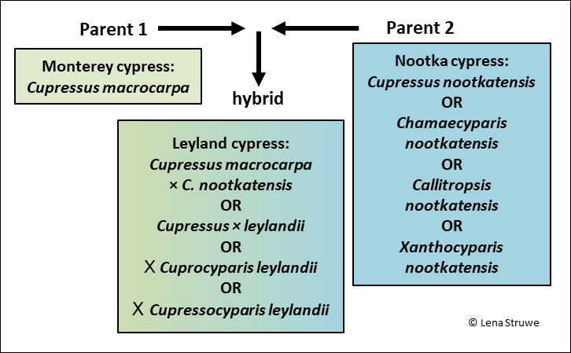
Hybrid names between genera

Slide 21
Major plant family changes
Traditionally used family names | Current classification (APG)
Aceraceae (maples) | Included in Sapindaceae
Asclepiadaceae | Included in Apocynaceae
Bombacaceae | Included in Malvaceae
Caesalpiniaceae | Included in Fabaceae
Cornaceae | Only two genera left in family, the rest in other families (Nyssaceae, Alangiaceae)
Dipsacaceae | Included in Caprifoliaceae
Liliaceae | Major split-up, only a small part left in Liliaceae, the rest now placed in other families
Loganiaceae | Major reclassification, less than half of genera left in family, rest moved to other families (Gelsemiaceae, Gentianaceae, Buddlejaceae, Gesneriaceae, etc.)
Myrsinaceae | Included in Primulaceae
Pyrolaceae | Included in Ericaceae
Scrophulariaceae | Major reclassification, resulted in just a few genera left in Scrophulariaceae, the rest placed in other families (Plantaginaceae, Orobanchaceae, etc.)
Sterculiaceae | Included in Malvaceae
Tiliaceae (basswoods etc.) | Included in Malvaceae
Verbenaceae | Some genera moved to Lamiaceae
Some examples of major changes in family organizations of flowering plant species.

Slide 22
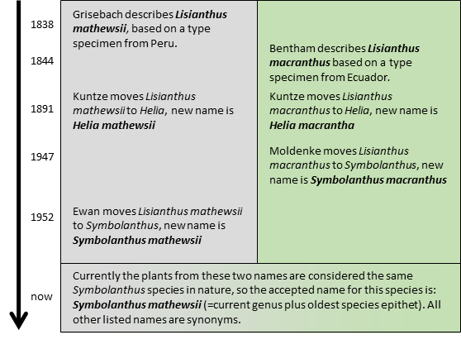
Merging of species, nomenclature history: Symbolanthus

Slide 23
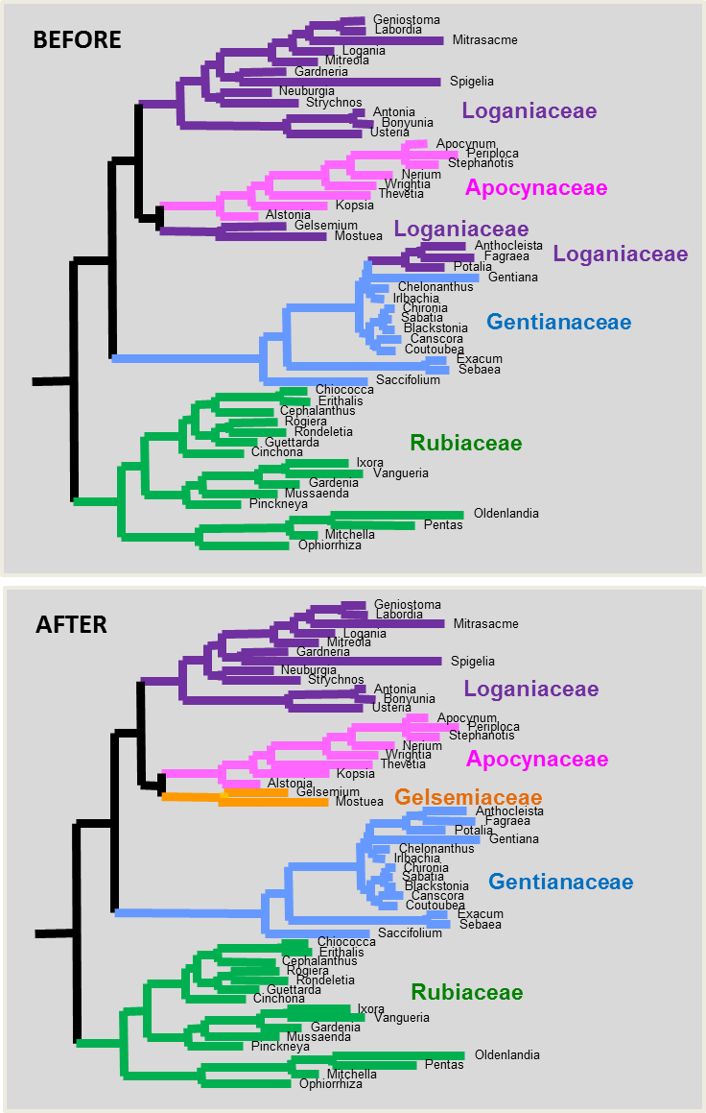
Principles of Phylogenetic Classification: Gentianales

Slide 24
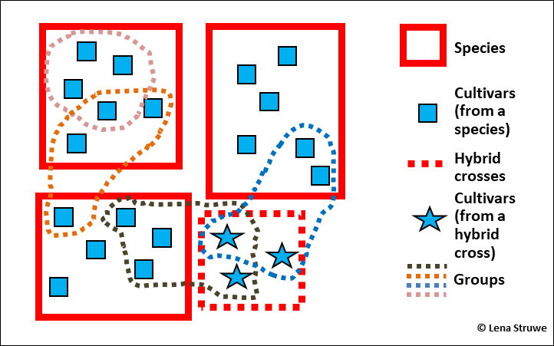
Cultigens

Slide 25
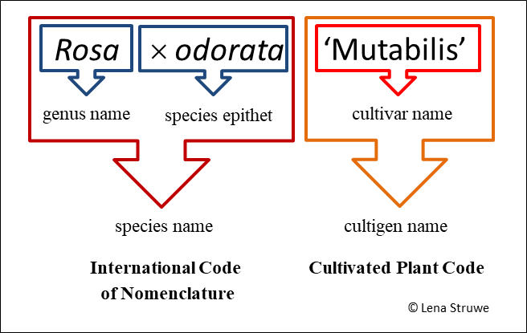
Cultivated Plant Code names: cultivars

Slide 26
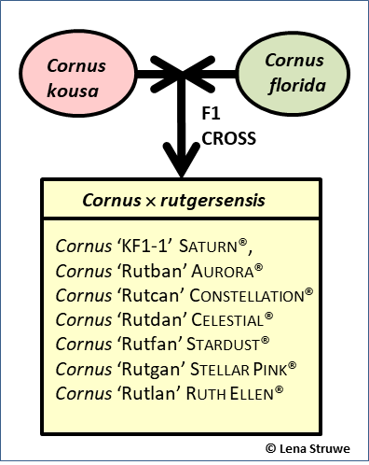
Cultivated hybrid naming

Slide 27
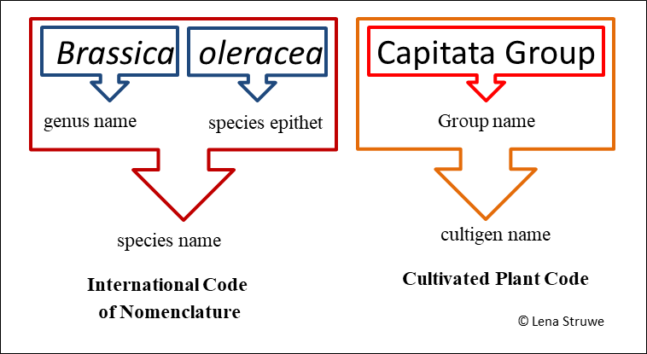
Cultivated Plant Code names: Groups

