Slide 1
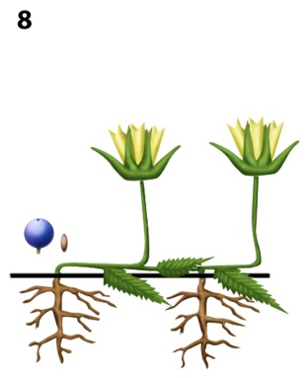
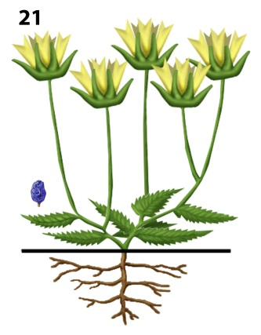
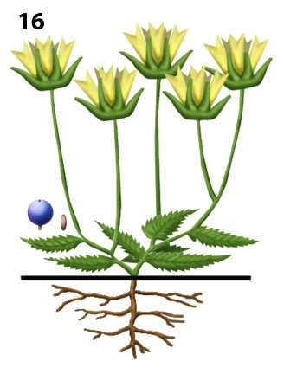
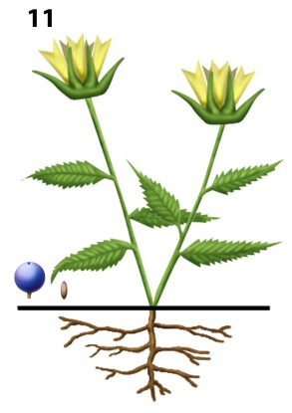
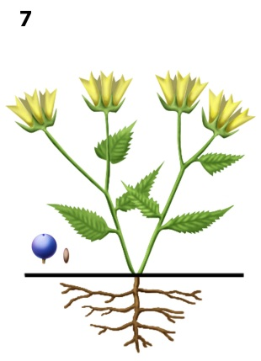
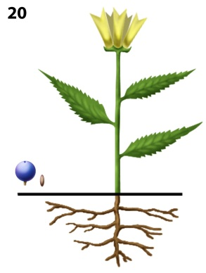
X. repens
2n = 16
(diploid)
Speciation in Xanthoanthe
on the island of San Andrés
X. grandicalyx
2n = 14
(diploid)
chr.
doubling
X
diploid
hybrid
(extinct)
& chr.
doubling
X. abortiva
2n = 22
(triploid)
X. multicaulis
2n = 44
(hexaploid)
X
X. serrata
2n = 28
(tetraploid)
X. flava
2n = 14 (diploid)

